Slide 1
Stack

Slide 2
Abstract Data Types
In computing, an abstract data type is a mathematical model for a certain class of data structures that have similar behavior; or for certain data types of one or more programming languages that have similar semantics.
An abstract data type is defined indirectly, only by the operations that may be performed on it and by mathematical constraints on the effects (and possibly cost) of those operations
An abstract data type is defined indirectly, only by the operations that may be performed on it and by mathematical constraints on the effects (and possibly cost) of those operations

Slide 3
Abstract Data Types (ADTs)
For example, an abstract stack data structure could be defined by two operations: push, that inserts some data item into the structure, and pop, that extracts an item from it; with the constraint that each pop always returns the most recently pushed item that has not been popped yet.
Abstract data types are purely theoretical entities, used (among other things) to simplify the description of abstract algorithms, to classify and evaluate data structures, and to formally describe the type systems of programming languages

Slide 4
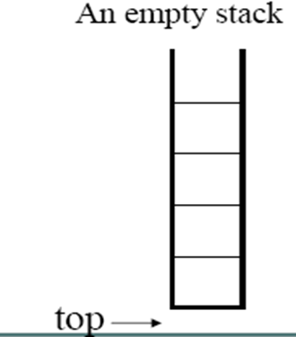
Stack
A stack is also known as a Last-In-First-Out (LIFO) list.
A stack is a linear structure in which items are added or removed only at one end the top.
The depth of stack is the number of elements it contains.
An empty stack has depth zero.

Slide 5
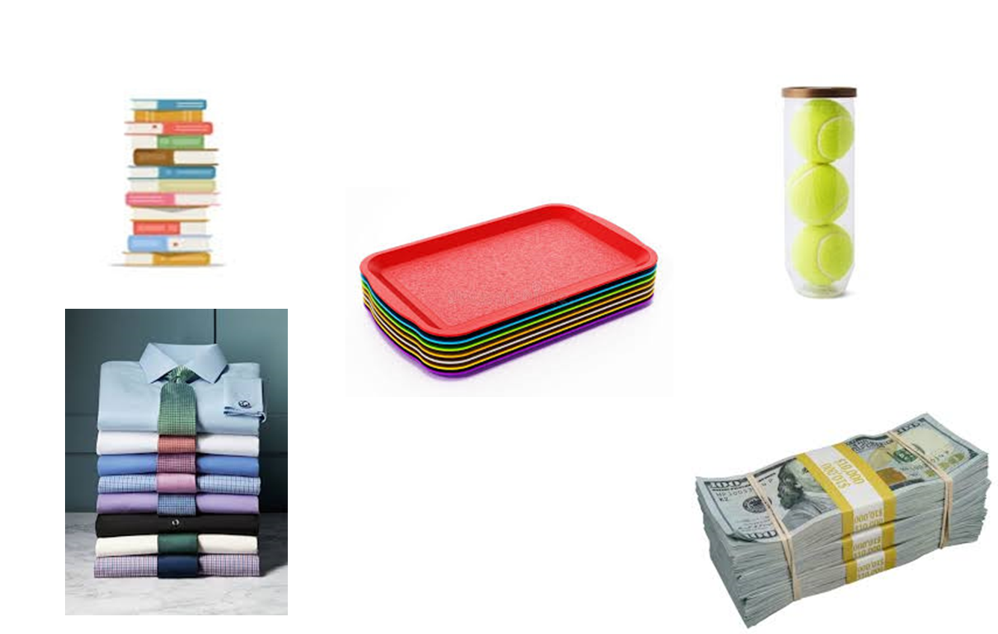
Stack –Real world examples

Slide 6
Stack –Applications
Evaluation of Arithmetic Expressions
Backtracking
Delimiter Checking
Reverse a Data
Processing Function Calls
Undo/Redo operations

Slide 7
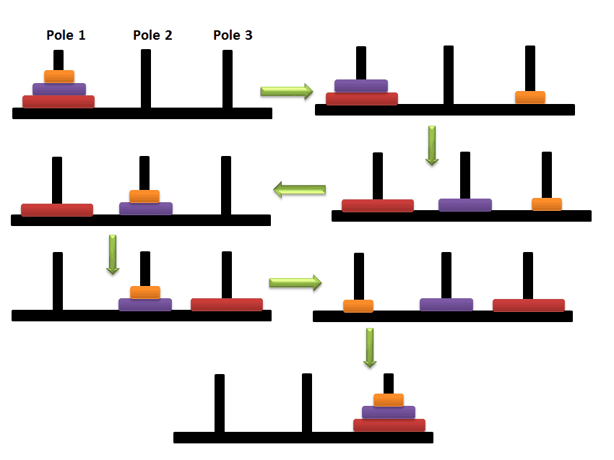

Stack –Applications
Color sorter Game
Tower Of Hanoi
Tower Of Hanoi
Color sorter Game

Slide 8
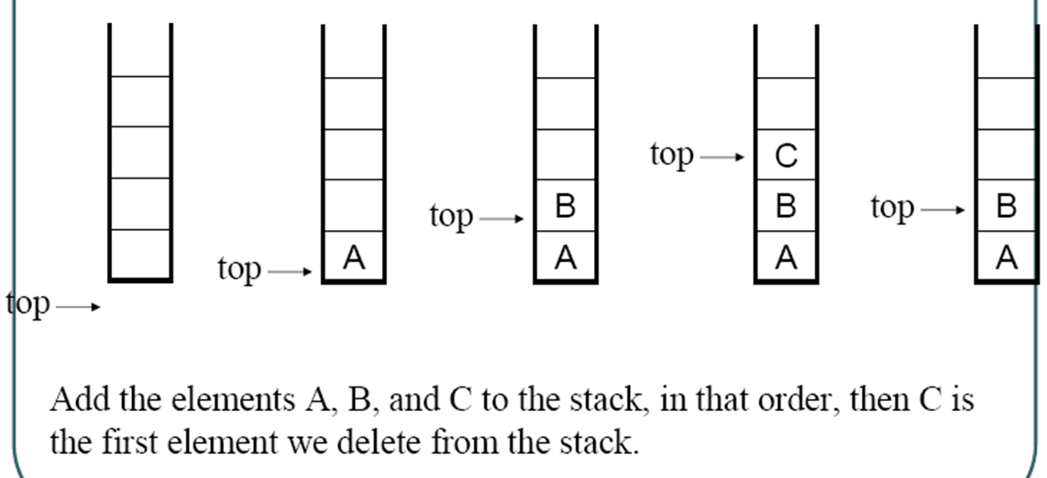
Stack Example

Slide 9
Stack Operations
A stack is an ADT that supports following operations:
Push(S:ADT,O:Element):ADT-Inserts object O onto top of stack S.
Pop(S:ADT):ADT-Removes the top object of stack S; if the stack is empty an error occur.
Top/peek (S:ADT):element – Returns the top object of the stack, without removing it; if the stack is empty an error occurs
Stack Overflow-Insert an element into the full stack/Insert an element while stack reaches to max size.
Stack Underflow-Pop an element from an empty stack
size(): how many items are in the stack?
isEmpty(): false if there are 1 or more items in stack, true otherwise

Slide 10
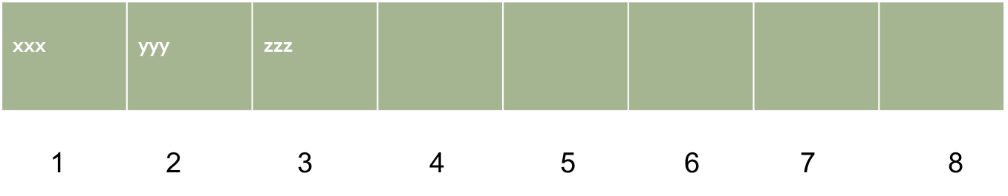
Implementing Stack using Array
STACK
TOP
3
8
MAXSTK

Slide 11
Push()
This procedure pushes an ITEM onto a stack
PUSH(STACK,TOP,MAXSTK,ITEM)
If TOP = MAXSTK, then
Print : Overflow, and Return
Set TOP = TOP + 1 [Increase TOP by 1]
Set STACK[TOP]= ITEM [Insert ITEM in new TOP position]
Return

Slide 12
Pop()
This procedure deletes the top element of stack and assigns it to the variable ITEM
POP(STACK,TOP,ITEM)
IF TOP = 0, then
Print : Underflow, and Return
Set ITEM = STACK[TOP] [Assigns TOP element to ITEM]
Set TOP= TOP - 1 [Decreases TOP by 1]
Return

Slide 13
Limitations
– The maximum size of the stack must be defined priori and cannot be changed
– Trying to push a new element into a full stack causes an implementation-specific exception

Slide 14
Exercise 1
Consider the following stack of characters, where STACK is allocated N=8 memory cells.
STACK=A,C,D,F,K,___,___,____
Describe the stack as the following operations take place.
POP(STACK,ITEM)
POP(STACK,ITEM)
PUSH(STACK,L)
PUSH(STACK,P)
POP(STACK,ITEM)
PUSH(STACK,R)
PUSH(STACK,S)
POP(STACK,ITEM)

Slide 15
Exercise 2
Suppose STACK is allocated N=6 memory cells and initially STACK is empty. Find the output of the following procedure.
Set A=2 and B=5
Call PUSH(STACK,A)
Call PUSH(STACK,4)
Call PUSH(STACK,B+2)
Call PUSH(STACK,9)
Call PUSH(STACK,A+B)
Repeat while Top!= 0
Call POP(STACK,ITEM)
End of loop

Slide 16
Polish Notation
Polish notation named after Polish mathematician Jan Lukasiewiez, refers to the notation in which the operator symbol is placed before its operands.
Reverse Polish notation refers to the notation in which operator symbol is placed after its operands.

Slide 17
Evaluation of expression
An expression is made up of operands, operators, and delimiters.
A/B-C+D*E-A*C
Arithmetic operators
+,-,*,/, %, and unary minus
Relational operators
<,<=,==,<.,>=, >, &&, ||, and !.

Slide 18
Priority of operators
To fix the order of evaluation, each operator is assigned a priority.
The C++ rule is that for all priorities, evaluation of operators of the same priority will proceed left to right.
A/B*C will be evaluated as (A/B)*C.
X=A/B-C+D*E-A*C will be evaluated as
X=(((A/B)-C)+(D*E))-(A*C).

Slide 19
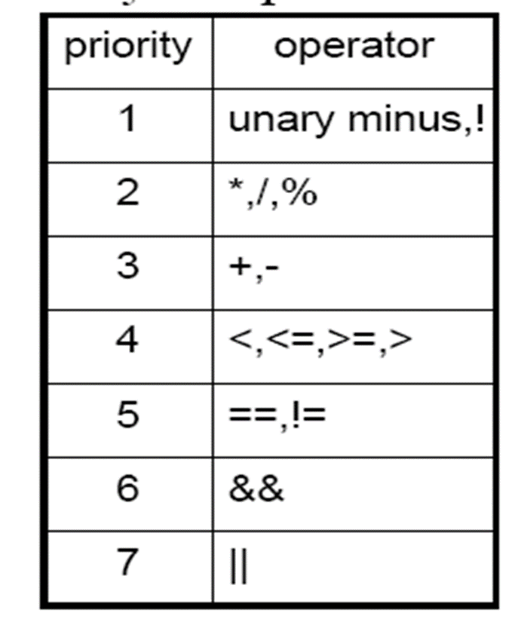
Priority of operators

Slide 20
Postfix notation
A compiler accepts an expression and produces correct code by reworking the expression into a form called postfix notation.
The conventional way of writing an expression is called infix- the operators come in-between the operands
Infix A*B/C has postfix AB*C/.
Infix: A/B-C+D*E-A*C
Postfix: AB/C-DE*+AC*-

Slide 21
Postfix Evaluation algorithm
This algorithm finds the VALUE of an arithmetic expression P written in post fix notation.
1. Add a right parenthesis ”)” at the end of P [This acts as sentinel]
2. Scan P from left to right and repeat Step 3 and 4 for each element of P until the sentinel “)” is encountered.
3. If an operand is encountered, put it on STACK.
4. If an operator ɸ is encountered then
a. Remove the two top elements of STACK, where A is the top element and B is the next to top element.
b. Evaluate B ɸ A
c. Place the result of b back to the STACK
[End of if structure]
[End of step 2 loop]
5. Set VALUE equal to the top element on STACK
6. Exit

Slide 22
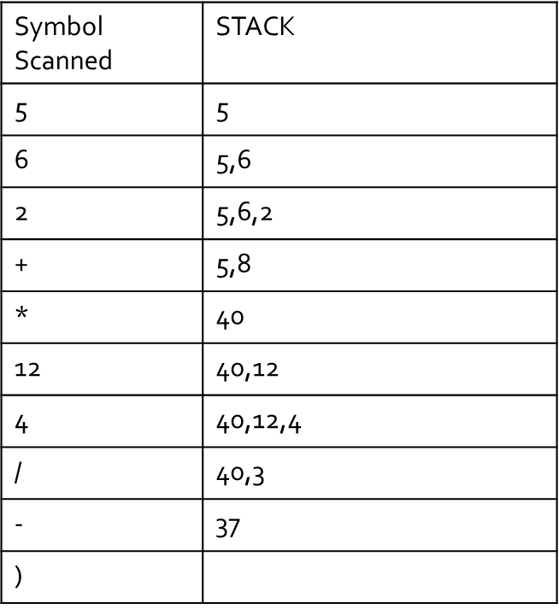
Example

Slide 23
Infix to Postfix: Example
3 5 6 * + 7 8 5 + * –
3 + 5 * 6 – 7 * (8 + 5)=
A/B-C+D*E-A*A/B-C+D*E-A*C =
5+ 3 + 4 + 1=
(5 + 3) * 10=
(b * b – 4 * a * c) / (2 * a) =
AB/C-DE*AC*-+
5 3 + 4 + 1 +
5 3 + 10 *
b b * 4 a * c*-2a*/

Slide 24
Evaluating Arithmetic Expression
The computer usually evaluate an arithmetic expression written in infix notation in two steps:
First it converts the expression to postfix notation, and
Then it evaluates the postfix expression.

Slide 25
Infix to postfix conversion algorithm
There is an algorithm to convert an infix expression into a postfix expression. It uses a stack; but in this case, the stack is used to hold operators rather than numbers.
The purpose of the stack is to reverse the order of the operators in the expression. It also serves as a storage structure, since no operator can be printed until both of its operands have appeared.
In this algorithm, all operands are printed (or sent to output) when they are read. There are more complicated rules to handle operators and parentheses.

Slide 26
Infix to postfix conversion algorithm
POLISH(Q,P)
Suppose Q is an arithmetic expression written in infix notation. This algorithm finds the equivalent postfix expression P.
1. Push “(“ onto STACK , add “)” to the end of Q.
2. Scan Q from left to right and repeat Step 3 to 6 for each element Q until the STACK is empty:
3. If an operand is encountered, add it to P.
4. If a left parenthesis is countered push it onto the STACK.
5. If an operator ɸ is encountered then
a. Repeatedly pop from the STACK and add to P each operator (on the top of the STACK) which has the same precedence as or higher precedence than ɸ.
b. Add ɸ to STACK
[End of If Structure]

Slide 27
Infix to postfix conversion algorithm (con’d)
6. If a right parenthesis is encountered, then:
a. Repeatedly pop from the STACK and add to P each operator (on the top of the STACK) until a left parenthesis is encountered.
b. Remove the left parenthesis. [Do not add the left parenthesis to P].
[End of if structure]
[End of If structure]
7. Exit

Slide 28
Example
Example:
1. A * B + C becomes A B * C +
The order in which the operators appear is not reversed. When the '+' is read, it has lower precedence than the '*', so the '*' must be printed first.
We will show this in a table with three columns. The first will show the symbol currently being read. The second will show what is on the stack and the third will show the current contents of the postfix string. The stack will be written from left to right with the 'bottom' of the stack to the left.

Slide 29
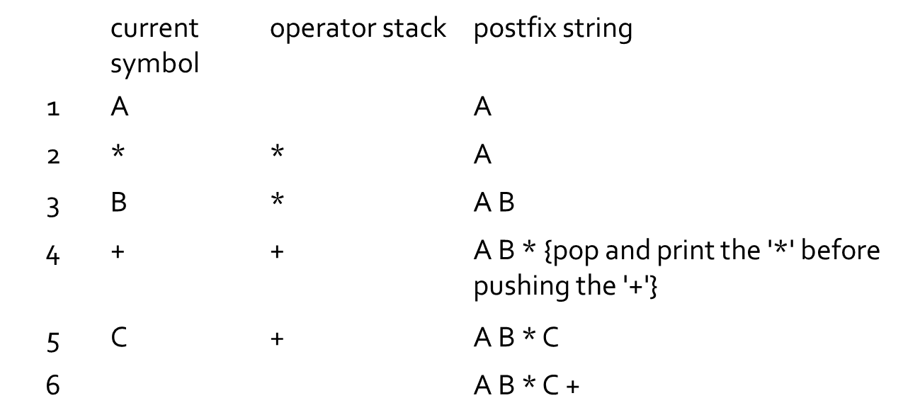
Example
A * B + C

Slide 30
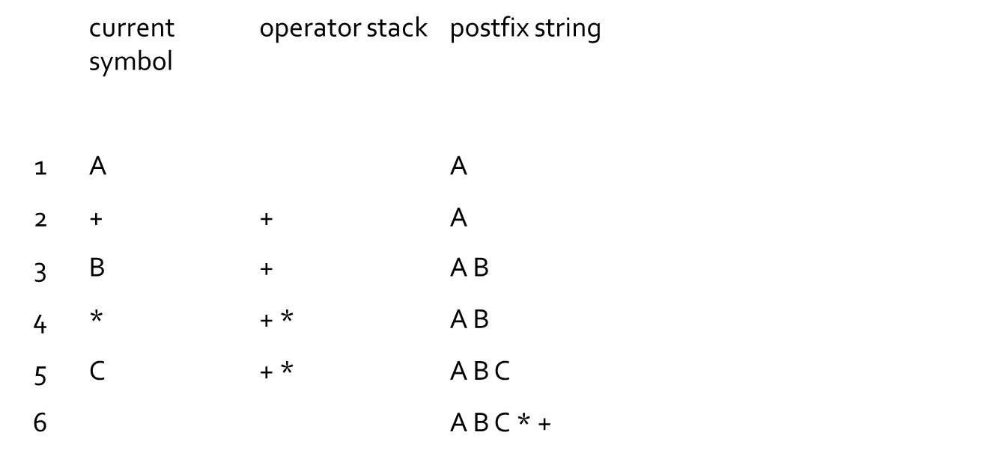
Example
A + B * C

Slide 31
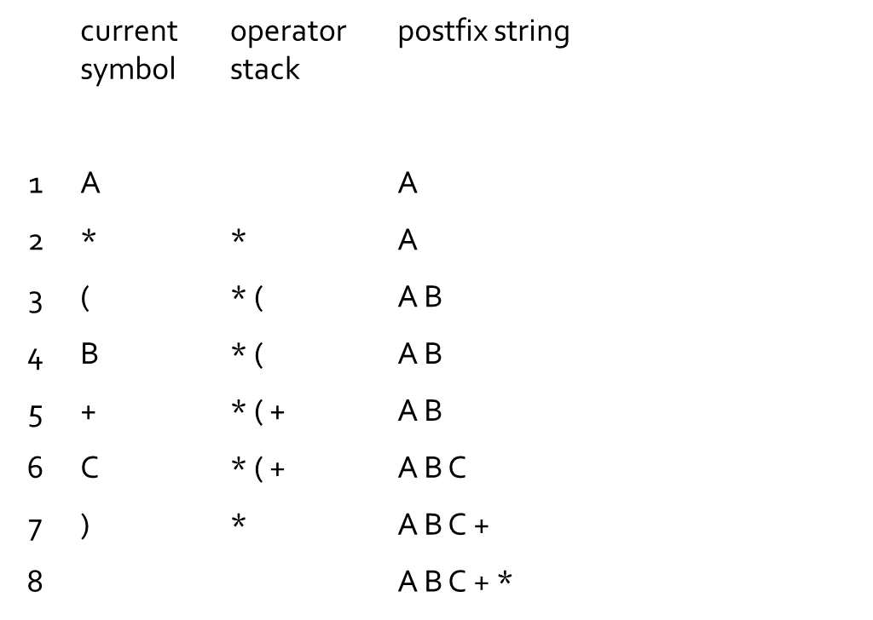
Example
A * (B + C)

Slide 32
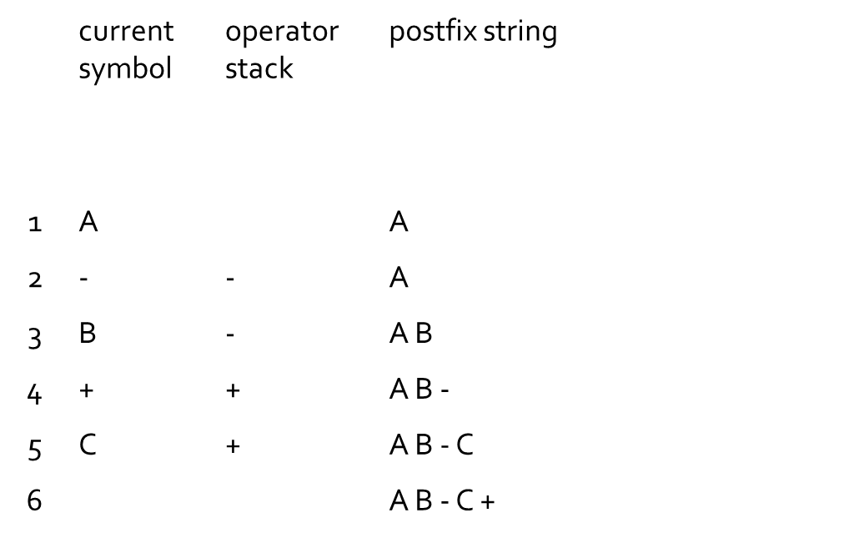
Example
A - B + C

Slide 33
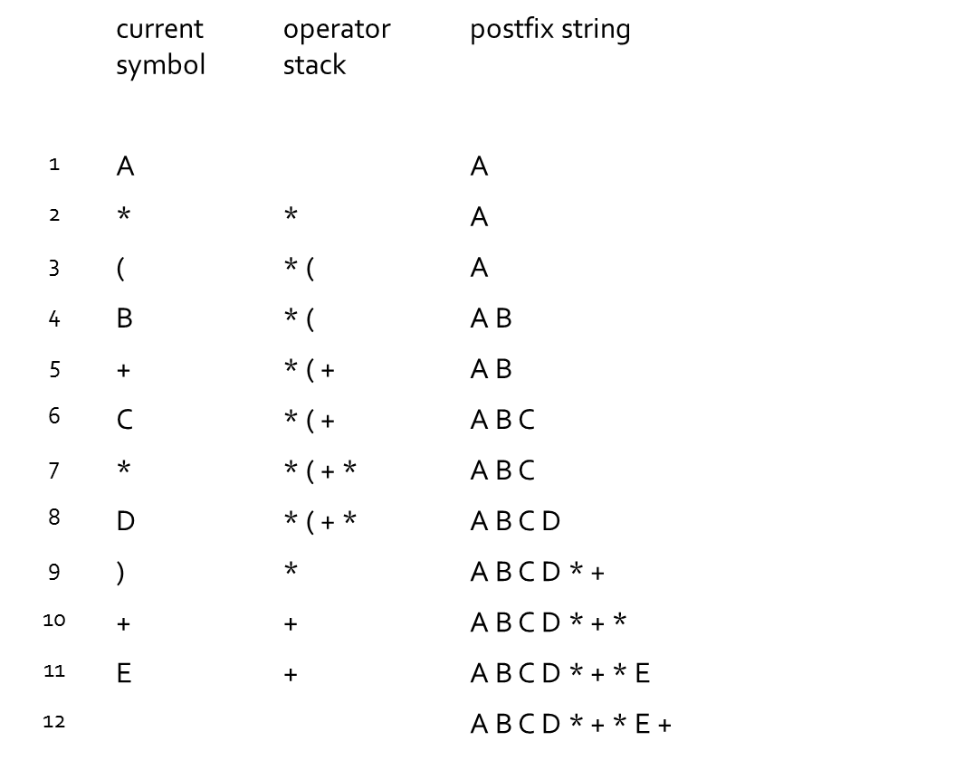
Example
A * (B + C * D) + E

